Slide 1


FG-2021
Face and
Gesture Recognition
Varshini Devi Ilamurugu – Amrita Vishwa Vidyapeetham ,Chennai
(ch.en.u4aie20075@ch.students.amrita.edu)
Harini Kannan – Amrita Vishwa Vidyapeetham, Chennai
(ch.en.u4aie20050@ch.students.amrita.edu)
Sudarshan Rajaram – Amrita Vishwa Vidyapeetham, Chennai
ch.en.u4aie20065@ch.students.amrita.edu)

Slide 2

ABOUT US
We, as a curious group, intend to explore the new universe we've been presented to. We believe that acquiring real-world experience on a well-known platform like this is the best approach to progress. As AI engineers, we should not only solve our physical issues. We also intend to solve some personal issues and are mainly focussing on that area. We think that make us unique and let us stand out of the group.

Slide 3

PROBLEM STATEMENT DETAILS
So here, in the problem statement we haven’t limited ourselves to face and gesture recognition. But also tried to explore emotion recognition and chatbots. You may have a confusion how any of these can be related. But our ultimate proposal is “MACHINES AS SOULMATES” . So we are in a idea to go with these separate objectives of facial, emotion, gesture recogniton techniques with integration of chatbot.

Slide 4

01
Facial Recogniton
03
EMOTION RECOGNITION
02
GESTURE RECOGNITION
04
CHATBOTS
Application : MACHINES AS SOULMATES
Integration of separate ideas!!

Slide 5
A soulmate without a soul!!!
Humans are intelligent, great inventors, discoverers, and have got anything they wanted. But deep down inside, people are stressed, depressed, leading a dark life on their own. Why can’t other humans help them? The reason is very evident. Everyone have feelings and everyone has got their own problems to deal with.
But when talking about machines, they would completely understand us without any second thoughts and could help us to heal ourselves. They could be our moral support, emotional pillow, our mentors, our friend…. Could be the real soul mate whom we really wanted. Sounds amazing, isn’t it?

Slide 6
What does any of this have to do with a chatbot?
What is interesting about computer/machine just recognizing our faces, actions or emotions?
Lets make it more interesting by integrating them with chatbot!!!
A chatbot is an artificial intelligence (AI) software that can simulate a conversation (or a chat) with a user in natural language and is often described as one of the most advanced and promising expressions of interaction between humans and machines.
By integrating chatbot with these recognition software , we don’t even need to start a conversation or say anything. Based on our face, emotions and gestures the machine understands itself and talk to us in a more comforting way with efficient training.

Slide 7

Technical understandings
We are basically AI students. And as an AI student, we swore ourselves never to let go any thought only because its more of a fantasy. Because AI is a world of fantasy but never remains as a fantasy. Whatever we thought as fantasy in the past have been implemented now. So our idea “Machine being as soulmates”, Is definitely the best fantasy of any AI engineer. And we are never less! We have put forth our first and foremost step towards a bigger revolution. Technically thinking, this could never be possible if we never start working on it. All these recognition techniques would be the base of building such a soulmate close to our heart!

Slide 8
PROPOSED SOLUTION
01
Facial recognition

Slide 9
1) Store dataset in different folders and Input image 2) Detect features from face like eyes,nose,chin,cheek etc., 3) Transform the image such that it concentrates on main object 4) Crop the main part required for face recognition 5) This cropped image is passed to Deep neural networks 6) The image is transformed into 128D tensor vector 7) Take embedding from the image using openface-nnu model 8) Use pickle for labelling 9) Use scikit to train model, then test it. 10) Code for realtime using openCV
Steps we planned to do:

Slide 10
02
Using tensorflow, openCV in python
We plan to use an object detection code and apply transfer learning for analysis and synthesis of gesture.
Gesture recognition

Slide 11
Steps we planned to do:
1) Clone the repository of an object detection code
2) Collect images with our webcam in real-time
3) Crop the gestures and setup labels from the images
4) Label the images for different gestures
5) We plan to do 5 different gestures
6) Train the model with 13 pictures
7) And use 2 pictures to test the model
8) Then code for real-time detection using opencv

Slide 12
03
Using tensorflow, openCV in python
Emotion recognition
We plan to use FER 2013/mobileNet datset and apply transfer learning for analysis and synthesis of 07 different classes of emotions.

Slide 13
Steps we planned to do:
1) Import dataset images.
2) Change size to 224×224 for TensorFlow (according to FER).
3) Shuffle the dataset, so the model doesn’t learn the sequence.
4) Convert it into 4 dimension array and normalize it.
5) Import tensorflow and download the pre-trained model.
6) Perform transfer learning according to our requirement.
7) Use face detection algorithm to detect face.
8) Then code for real-time detection using openCV.

Slide 14
OUR SOULMATES
Design a face recognizer
01
02
Design an emotion recognizer
Design a gesture recognizer
03
04
Integrate with a chatbot

Slide 15
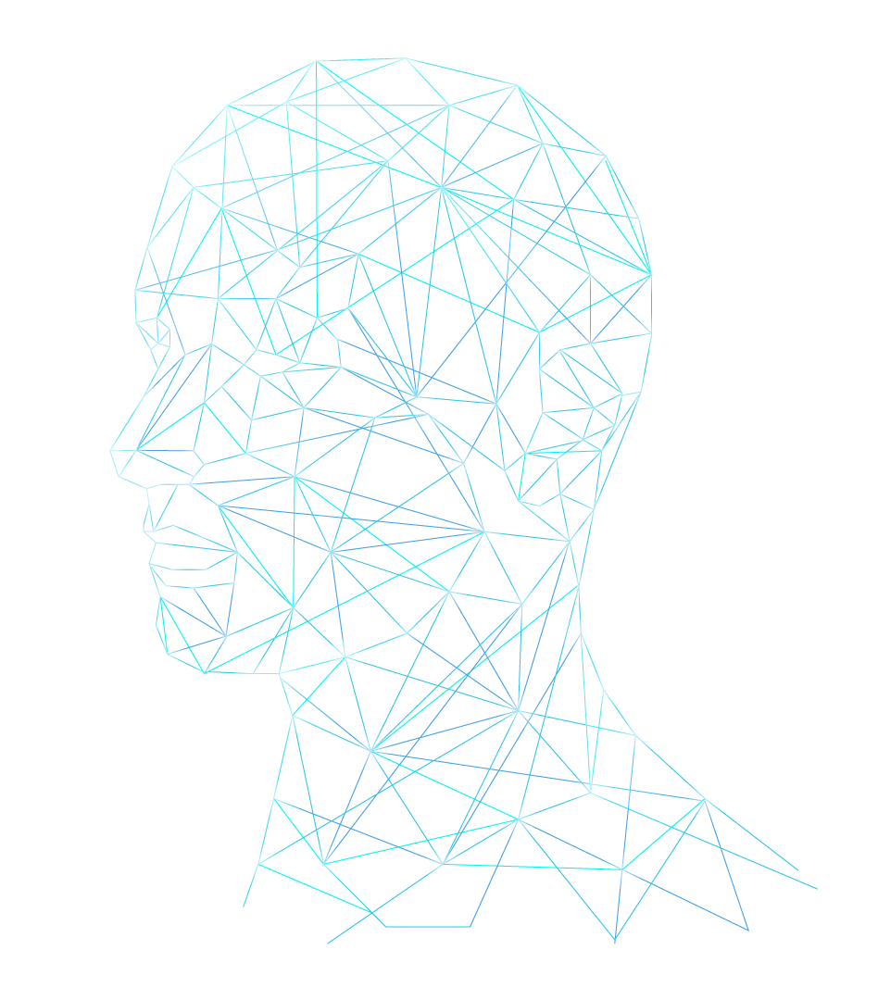
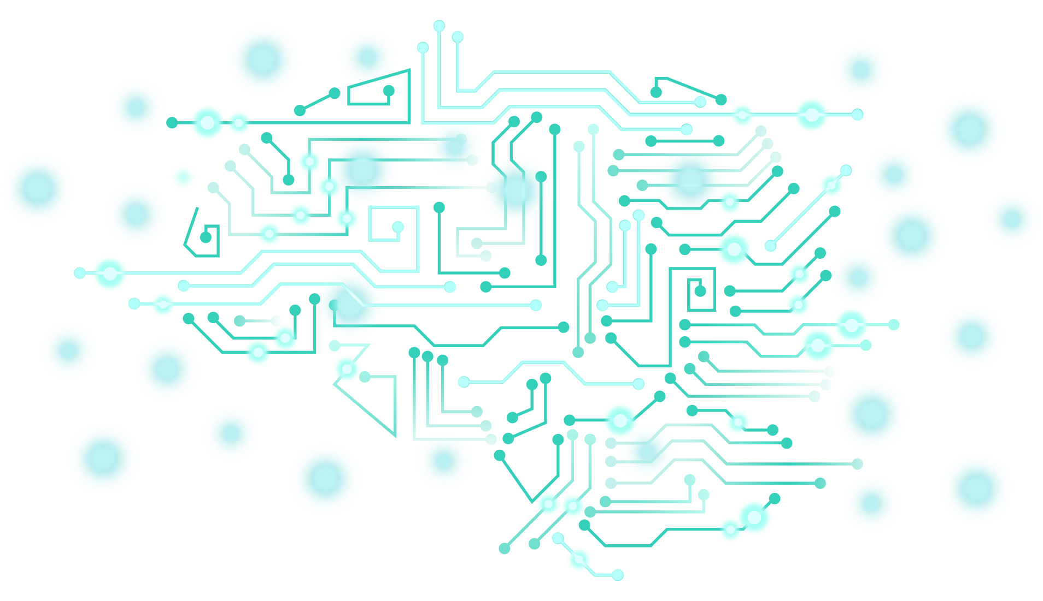
THANK YOU!!

